Slide 1
Detecting Sarcasm and Figurative Language in Tweets
DATS 6312 – Natural Language Processing | Final Project Presentation
Team:
Darsini Lakshmiah (G31629191)
Hussain Nathani (G36308827)
Rasika Nilatkar (G28505126)

Slide 2
Why is figurative language difficult?
Meaning often contradicts literal words
Tweets lack context, tone, facial cues
Informal style → emojis, sarcasm, exaggeration
Even humans misinterpret sarcasm, irony
Example: “Great, another Monday” → Literal meaning is positive but intent is negative.
Goal: Can NLP models automatically classify
Regular vs. Sarcasm vs. Irony vs. Figurative tweets?

Slide 3
Dataset Overview
Source
Kaggle - 'Tweets with Sarcasm and Irony' dataset. Based on research by Ling & Klinger (2016) analyzing differences between sarcasm and irony.
Size
81,403 training tweets + 8,119 test tweets. Nearly balanced across four classes: Regular, Sarcasm, Irony, and Figurative.
Annotation
Human-labeled into four mutually exclusive categories. Each tweet annotated for sarcasm, irony, regular and figurative.

Slide 4
Data Challenges
Noise & Irrelevance
Emojis, hashtags, mentions, and URLs require careful handling.
Imbalance
Figurative language instances are less frequent than literal.
Subjectivity
Human annotators may disagree on interpretation, leading to ambiguity.

Slide 5
Preprocessing Pipeline
Text Cleaning
Removing noise like URLs, mentions, and special characters.
Tokenization
Breaking text into individual words or sub-word units.
Stop Word Removal
Eliminating common words that add little meaning.
Lemmatization/ Stemming
Reducing words to their base form for consistency.

Slide 6
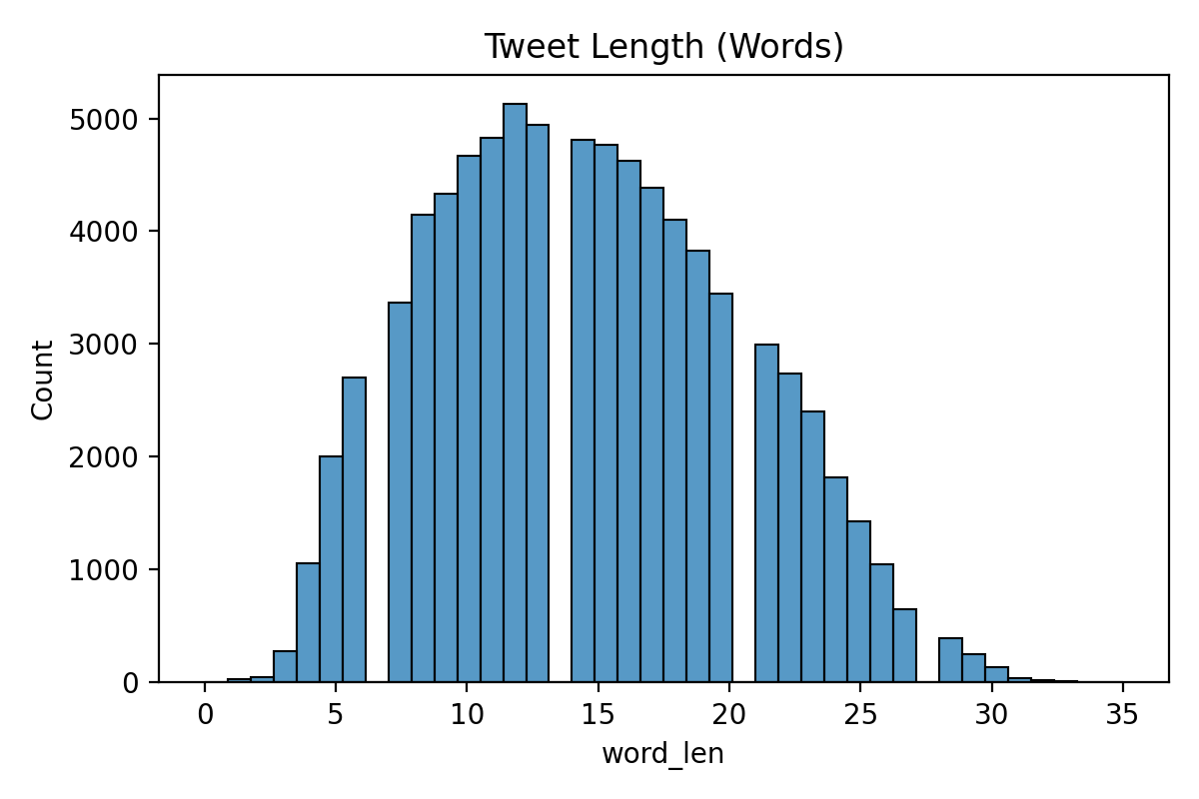
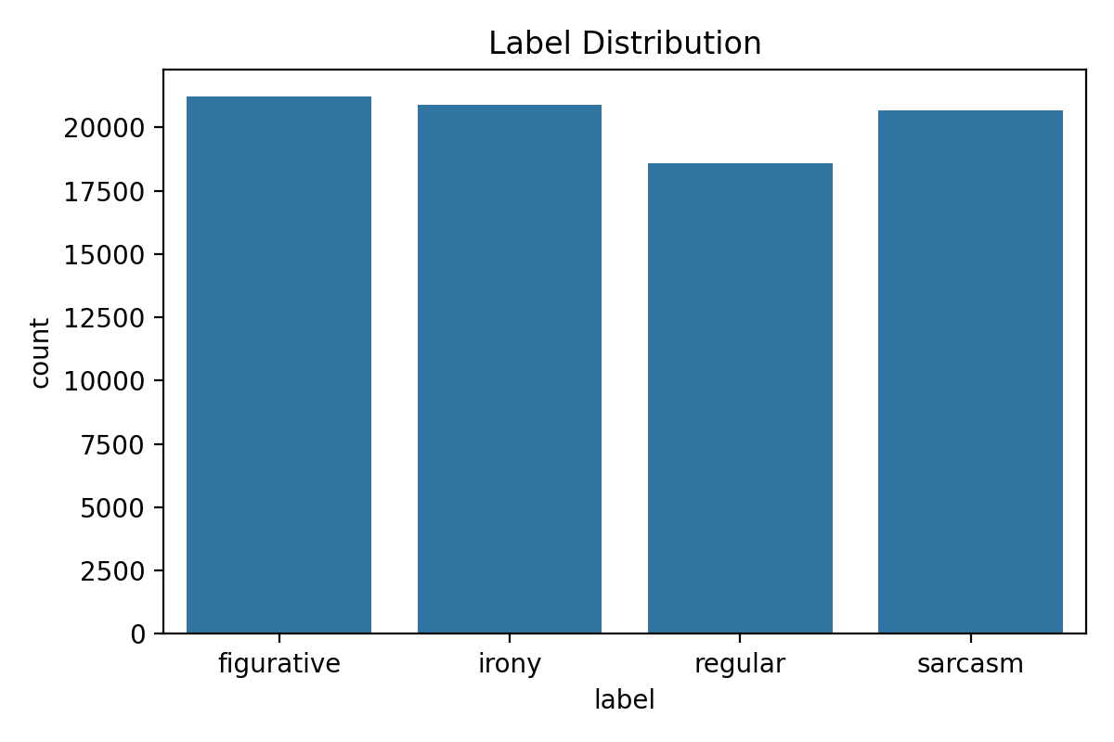
Exploratory Data Analysis
Most tweets contain 4–20 words, which aligns with typical tweet behavior.
Contains balanced data across all four classes.

Slide 7
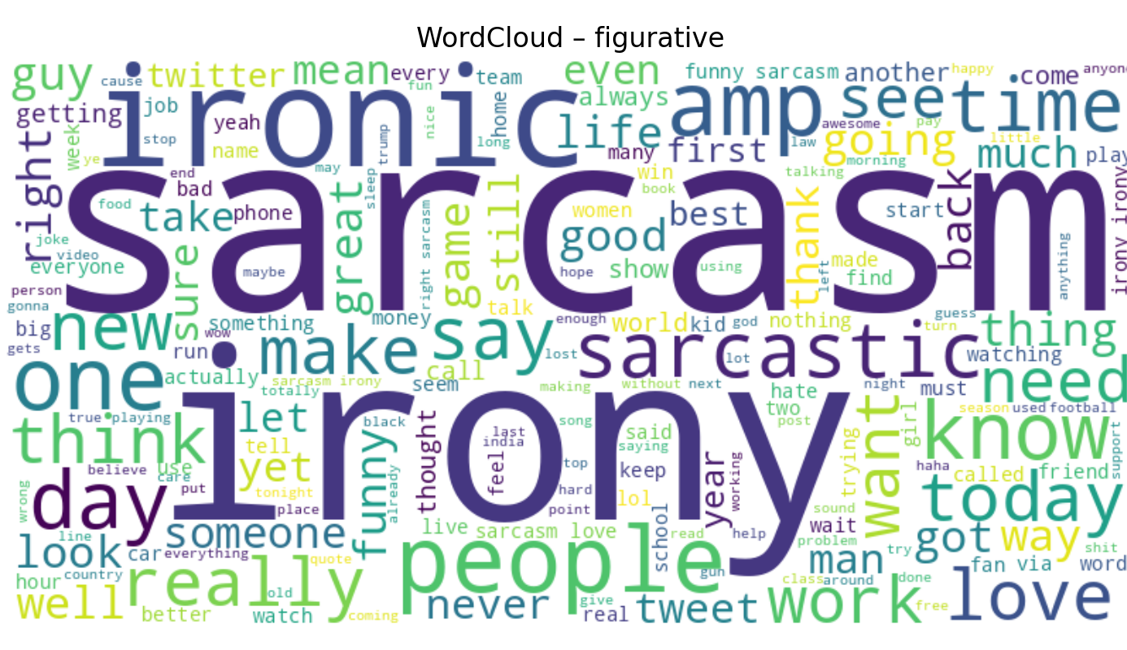
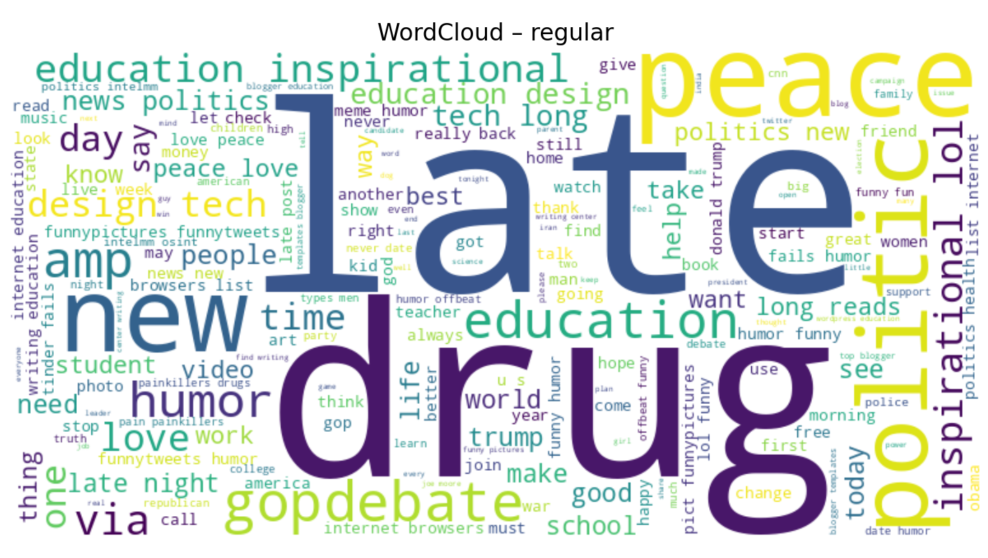
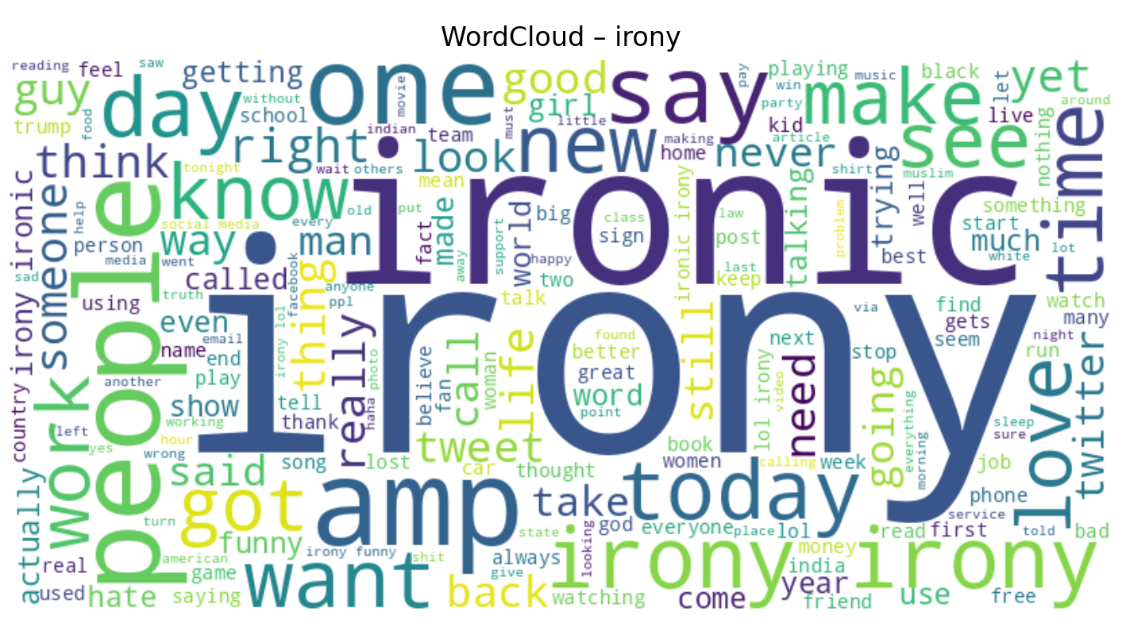
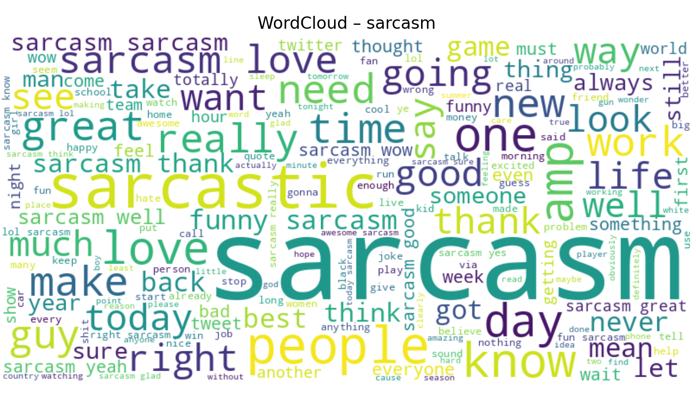
Figurative → no distinct lexical identity Regular → simple factual statements
Irony → situational contrast Sarcasm → exaggeration, emotional words

Slide 8
Modelling Approaches
Traditional ML
Logistic Regression with TF-IDF vectorization to establish an interpretable benchmark.
Deep Learning
BiLSTM using pre-trained GloVe embeddings to capture sequential dependencies and contextual cues.
Transformer Model
Fine-tuning DistilBERT for deeper semantic understanding of sarcasm and irony.

Slide 9
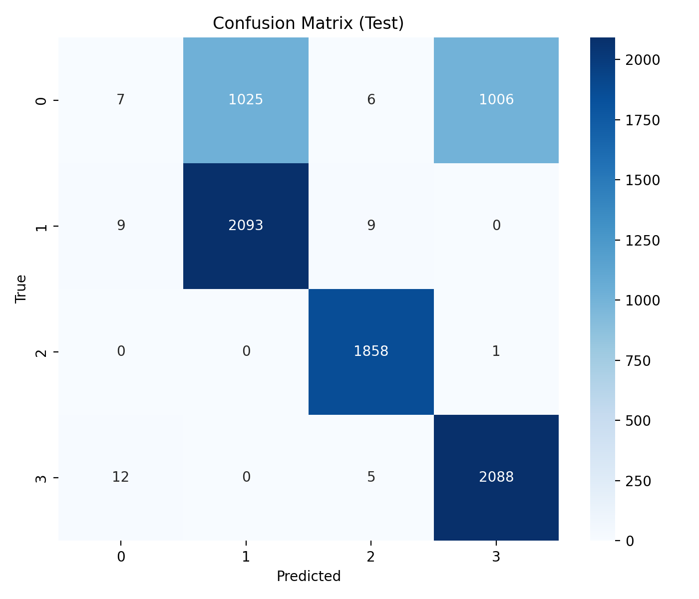
Model 1: Logistic Regression
TF-IDF (1–2 grams, 20k features)
Multinomial Logistic Regression
Grid search on C
Fast, interpretable baseline
Strengths: picks up lexical cues
Weakness: loses sequence/context info

Slide 10
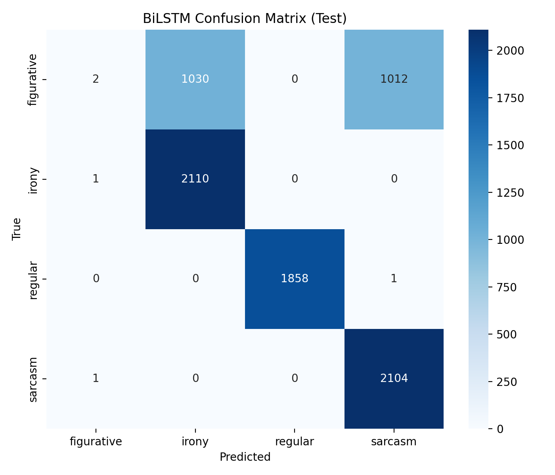
Model 2: BiLSTM
Architecture:
Trainable embedding layer (128-dim)
BiLSTM (128 units forward + backward)
Global Max Pooling
Dense (64) + Dropout
Softmax (4 classes)
Why BiLSTM?
Captures sequential patterns
Useful for sarcasm where reversal happens at sentence end

Slide 11

Model 3: DistilBERT
Transformer with contextual embeddings
Pre-trained on massive corpora
Fine-tuned for 3 epochs
Max length = 64
Why DistilBERT?
Understands semantics beyond word order
Best suited for subtle figurative meaning

Slide 12
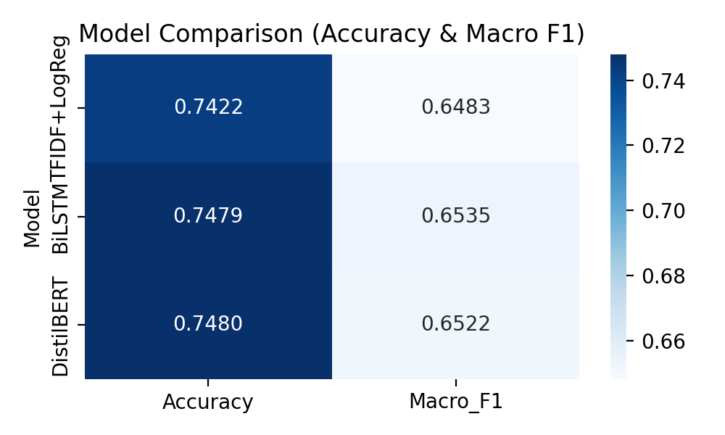
Results Observation
All models converge to ~74–75% accuracy.
Macro-F1 ~0.65 indicates uniform difficulty across models.
Dataset ambiguity (especially figurative class) limits performance.
Overlapping Characteristics
Semantic, Not Statistical

Slide 13
Error Analysis
Tweets without clear cues (no emoji/punctuation) are labeled regular.
Very short tweets cause models to default to majority classes.
Mixed-tone tweets (positive words + negative intent) confuse all models.
Models rely too much on keywords, leading to confident but wrong predictions.

Slide 14
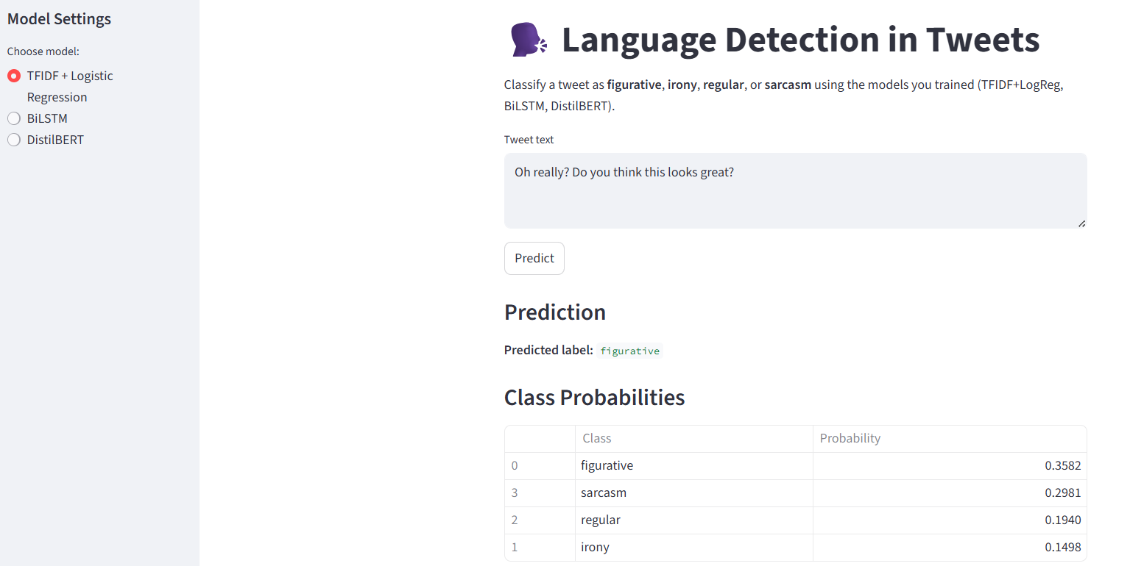
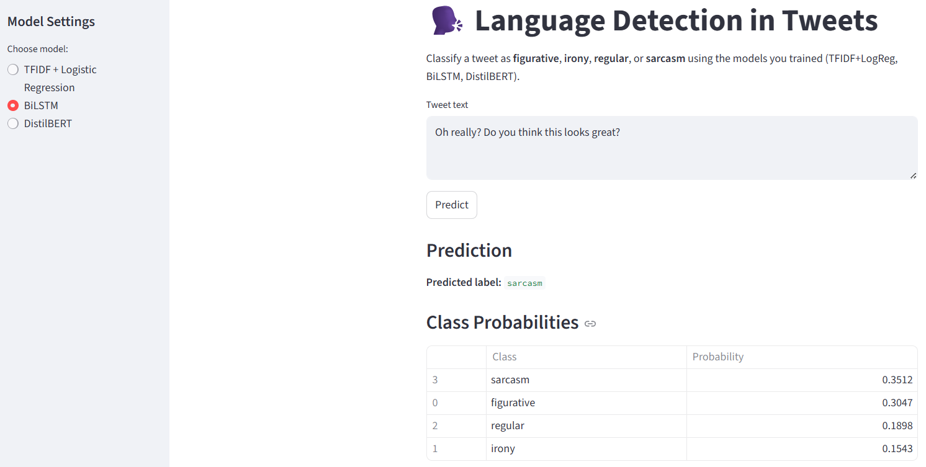
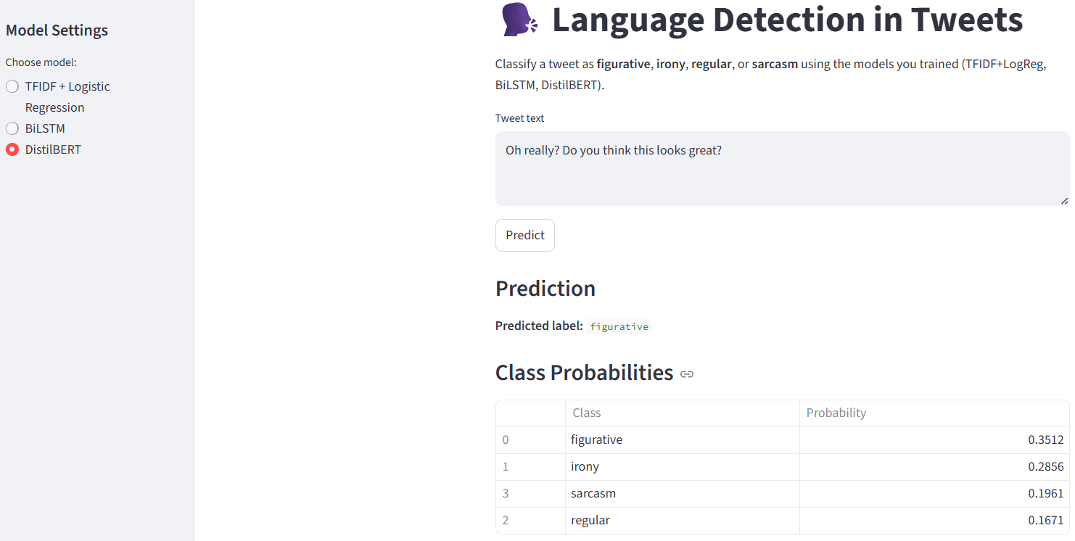
Streamlit App Demo

Slide 15
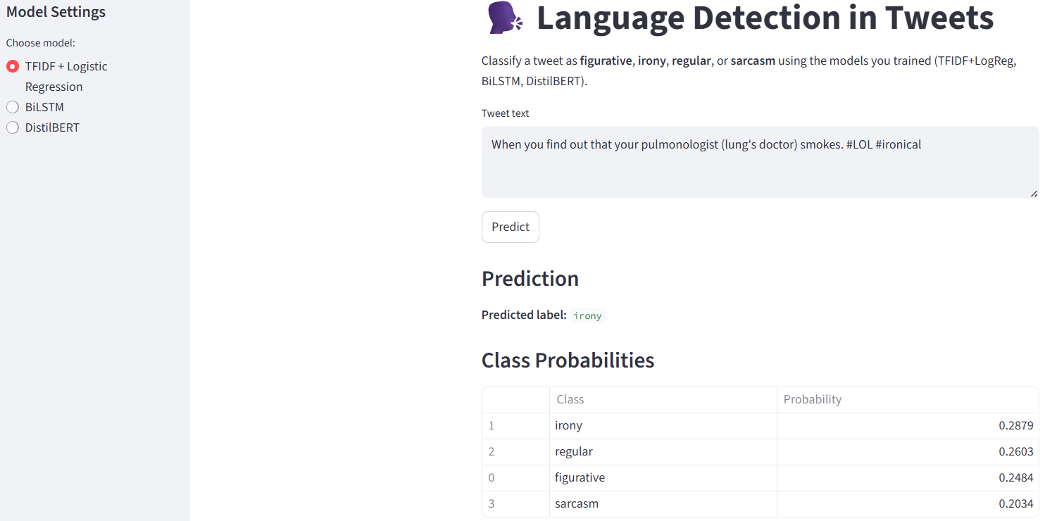
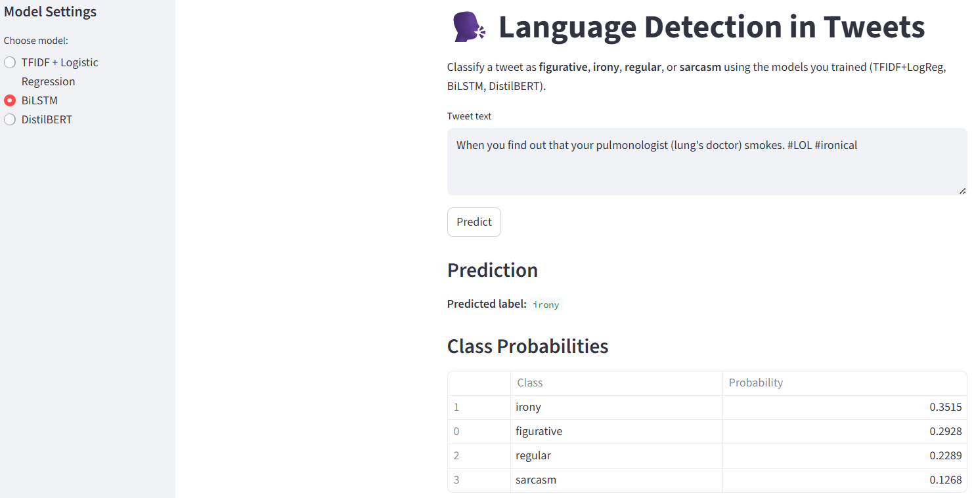
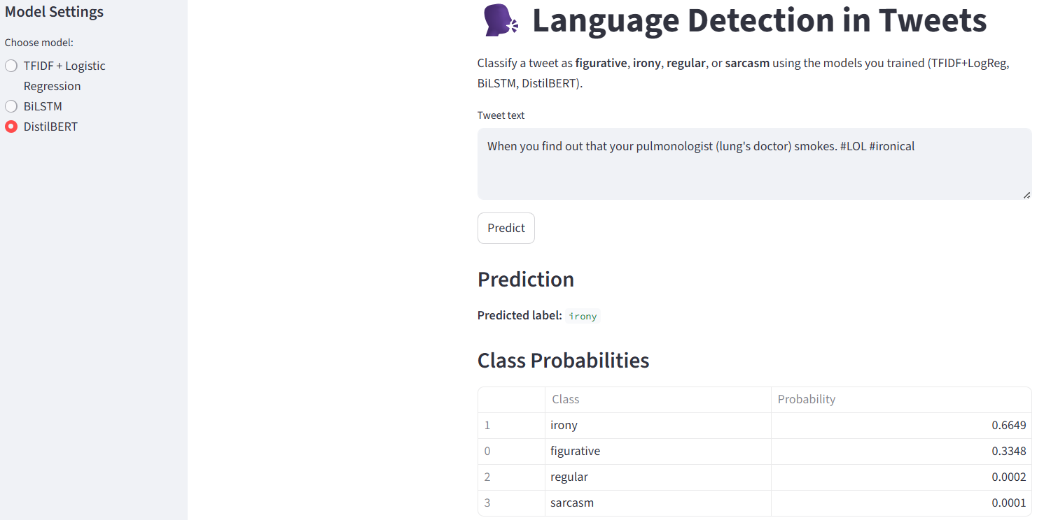
Streamlit App Demo

Slide 16
Future Work
Collect richer and more diverse figurative examples.
Use larger transformer models (RoBERTa/BERT-large).
Include conversation context, emojis, and sentiment cues.
Try multi-task learning (sarcasm + irony + sentiment).
Apply explainability tools to understand model errors.

Slide 17
Conclusion
74.8% accuracy on sarcasm & irony detection across all three models.
Figurative language remains the critical bottleneck, lacks distinct lexical markers.
Modern NLP excels at explicit figurative detection, but implicit meaning requires deeper semantic knowledge.

